Slide 1
Email Spam Detection - A Machine Learning Approach
Instructor: Rong Liu
BIA 660 – C – 19S
Author: Zixuan Wang, Shangjun Jiang,
Haodong Zhao, Rumeng Zuo

Slide 2




Team
Team Member:
Zixuan Wang
Team Member:
Shangjun Jiang
Team Member:
Haodong Zhao
Team Member:
Rumeng Zuo

Slide 3
Agenda
Project Background
Data Collection & Preprocessing
Exploratory Data Analysis
Modelling
Results Evaluation
Conclusion
Reference

Slide 4
Background
Email is primary source of communication in business world
People nowadays receive decades of emails everyday
Ham email with useful information sometimes has been mistaken for spam email
Better understanding spam/ham email to get business insight and expand email marketing influence
Text mining technique gain from BIA 660 can help us to detect spam email

Slide 5
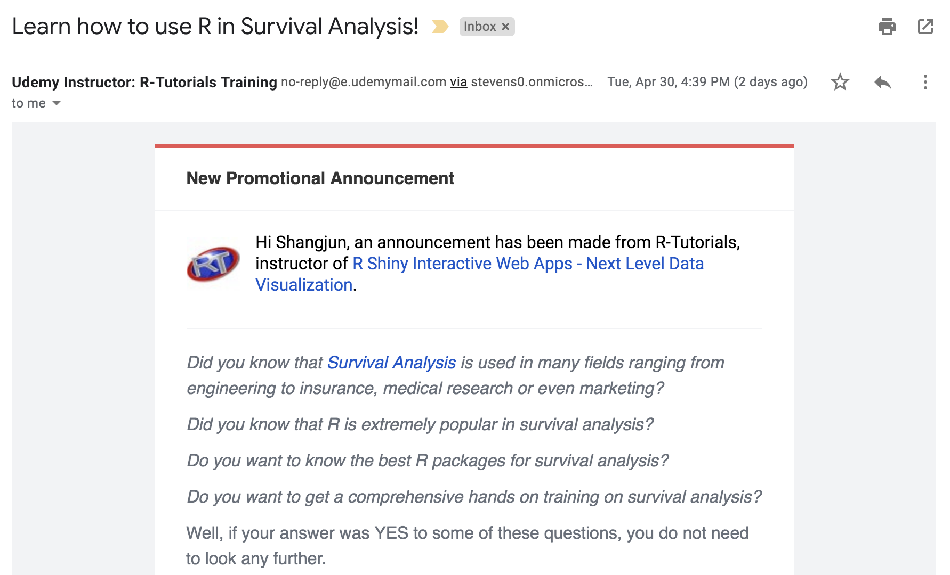
Data Collection
title
Programmed functions with beautifulsoup and selenium to login our personal emails and script the 5 parts of each email from Ham and Spam separately.
Merged Ham and Spam into one dataframe and transform it into a csv file
name
address
date
content

Slide 6
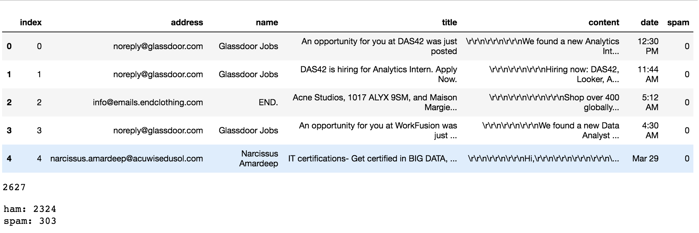
Data Collection – Result

Slide 7
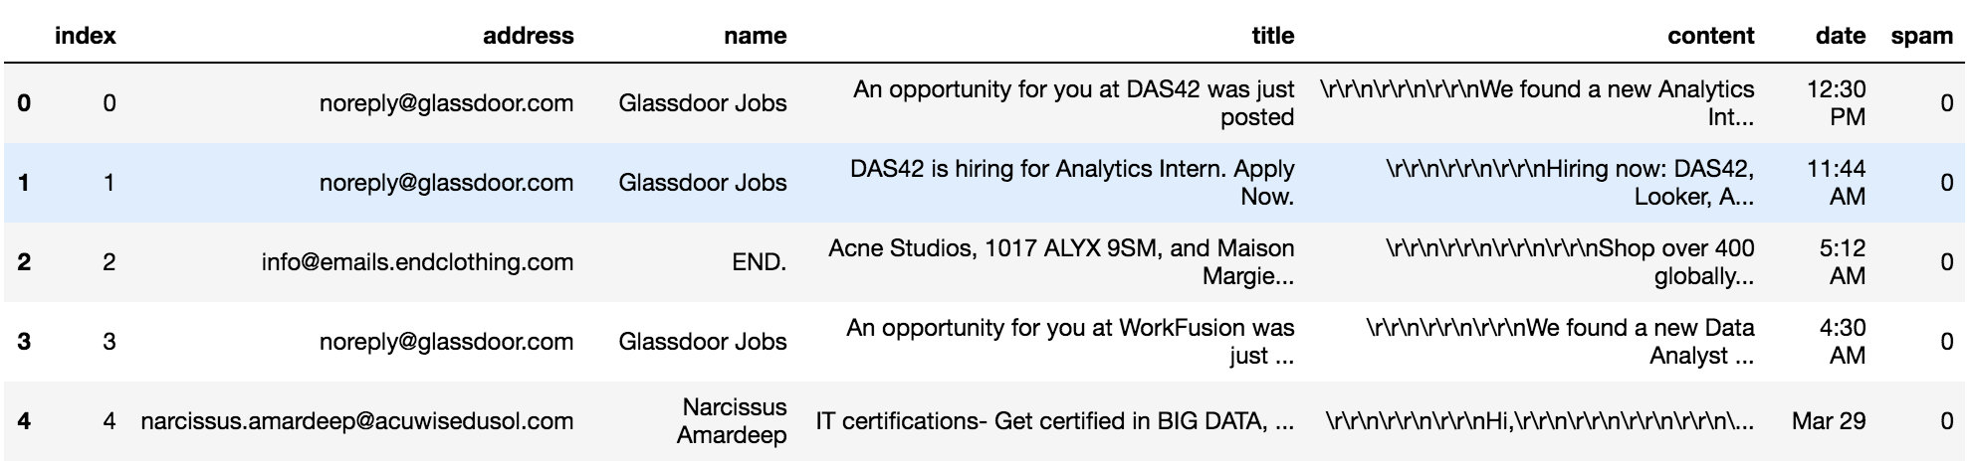
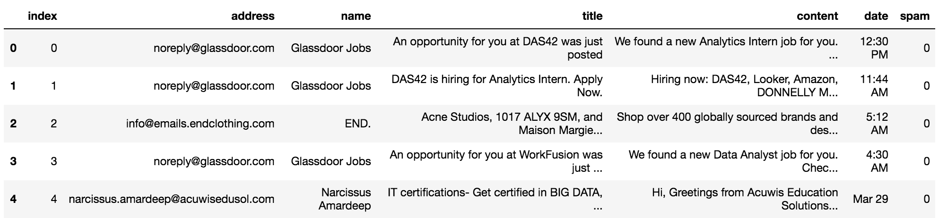
Data Preprocessing
Used regular expression to remove meaningless signal, Unicode(like Chinese character), white space(like newline, return)
After preprocessing, get clean, easy-to-read data and well-prepared for EDA & modelling

Slide 8
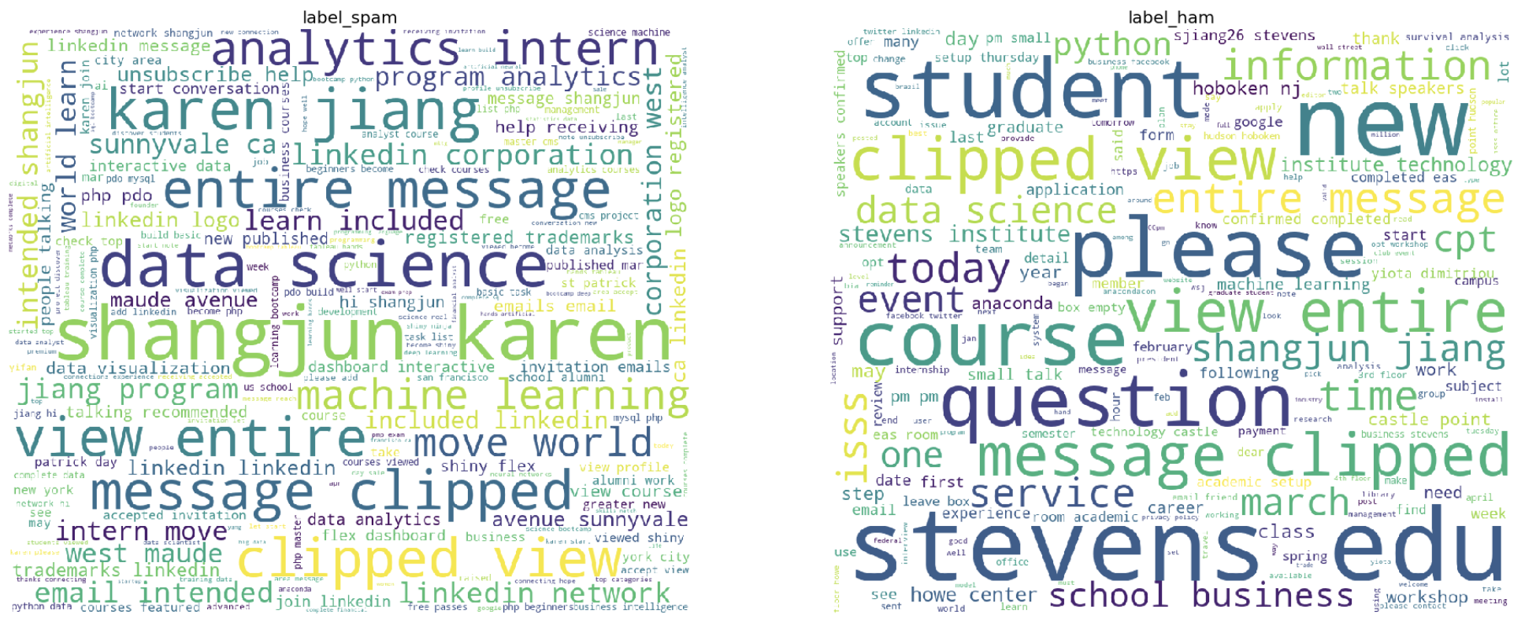
Exploratory Data Analysis
Word Cloud – 1st
Use all the text from both ‘title’ and ‘content’ columns
Get the knowledge of frequently appeared words in both labels

Slide 9
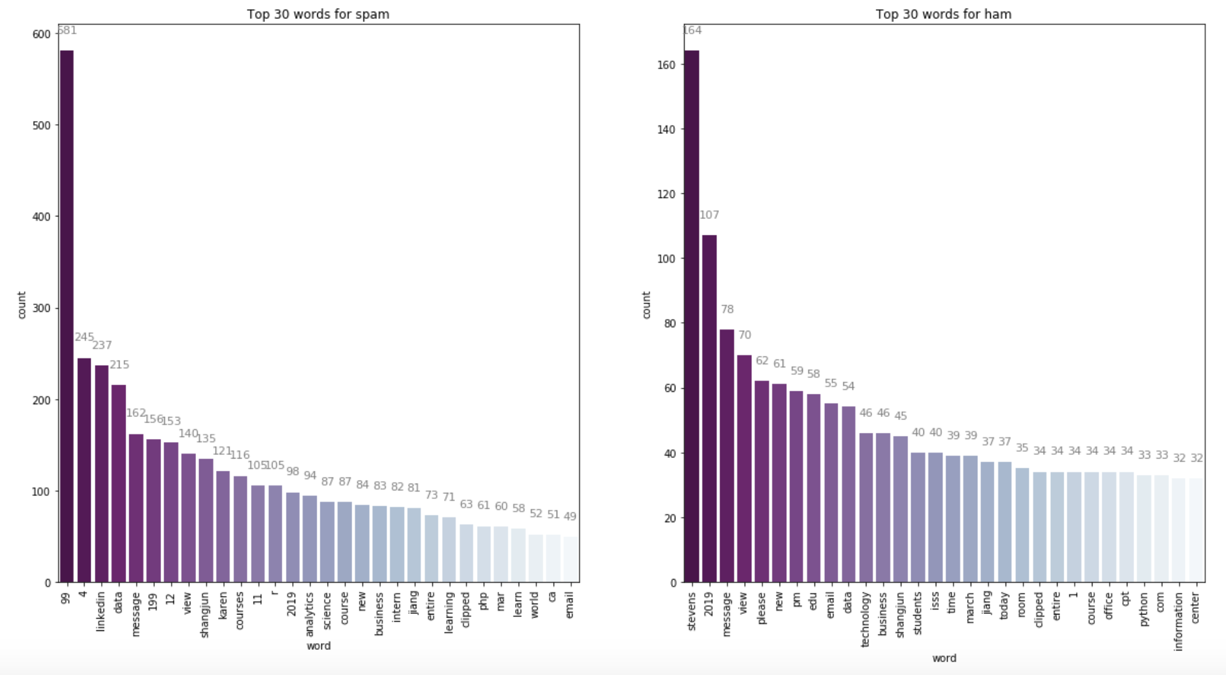
Exploratory Data Analysis
Bar Chart – 1st
Both ‘title’ and ‘content’ columns
Base on words frequency

Slide 10
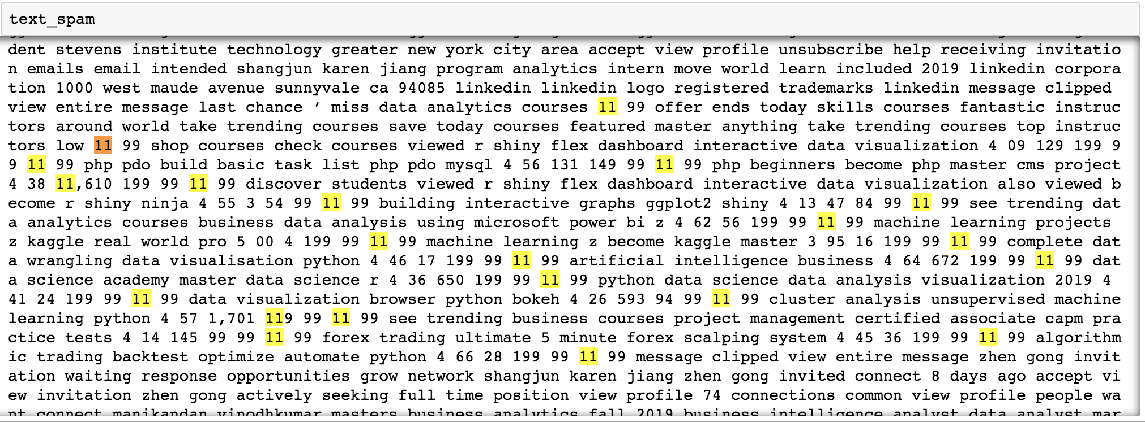
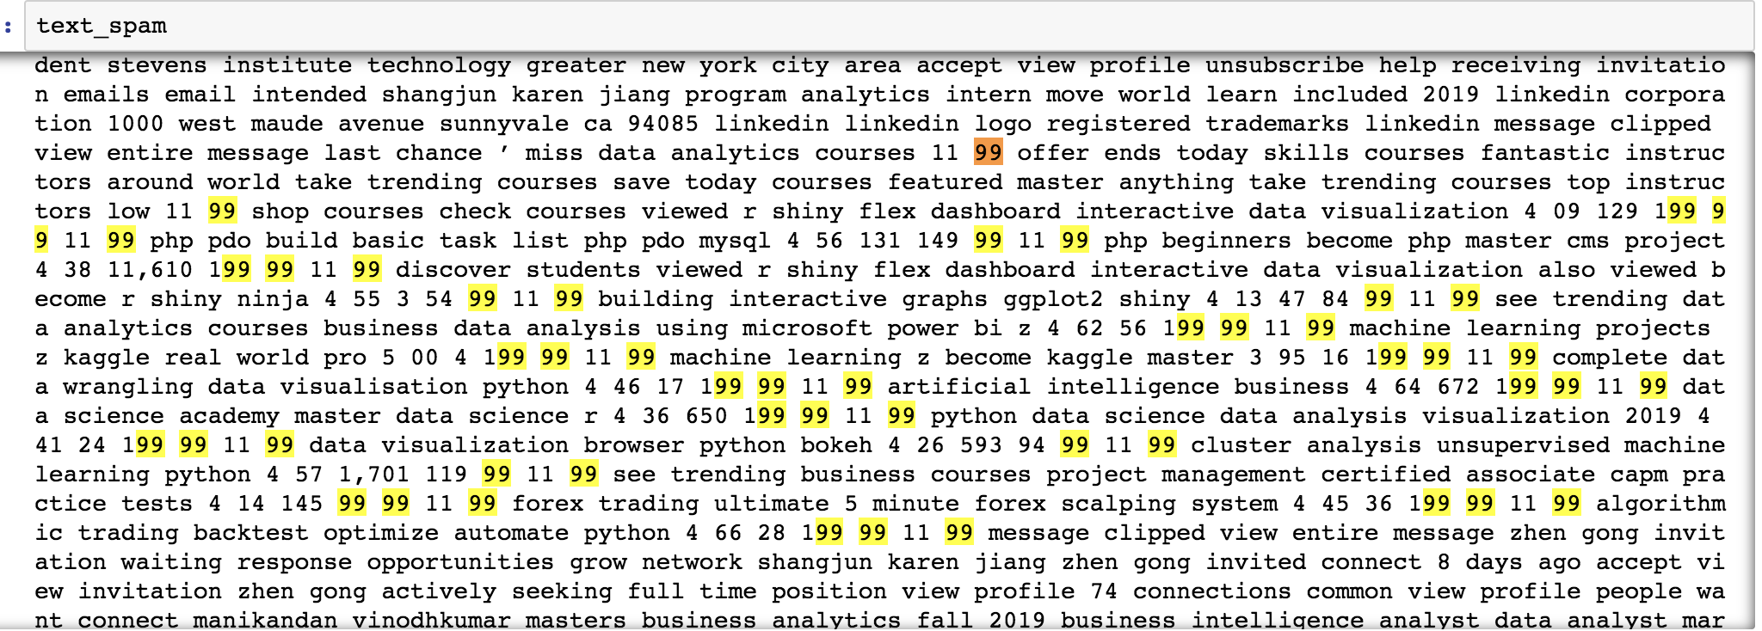
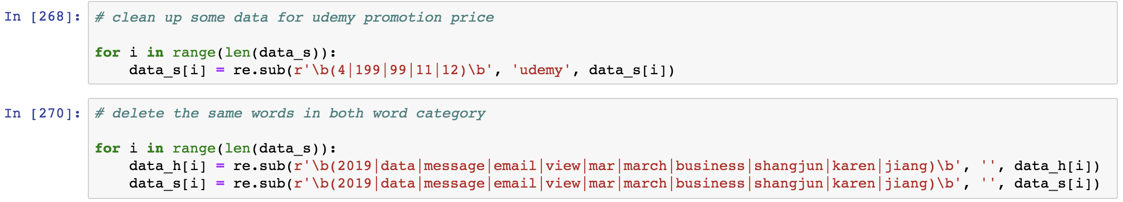
Exploratory Data Analysis
Data Clean-up

Slide 11
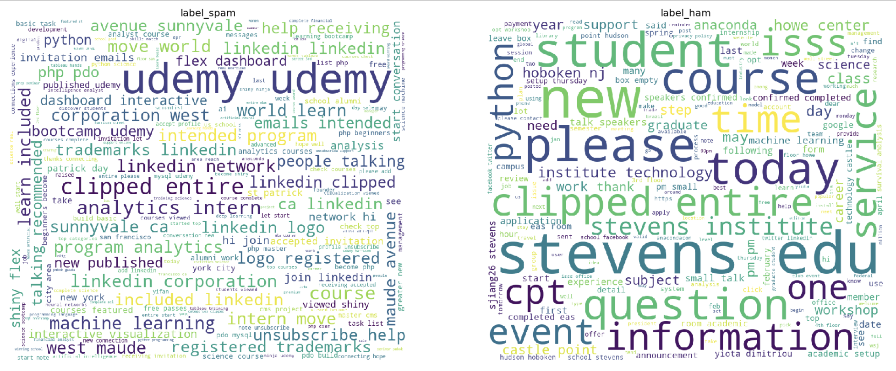
Exploratory Data Analysis
Word Cloud – 2nd

Slide 12
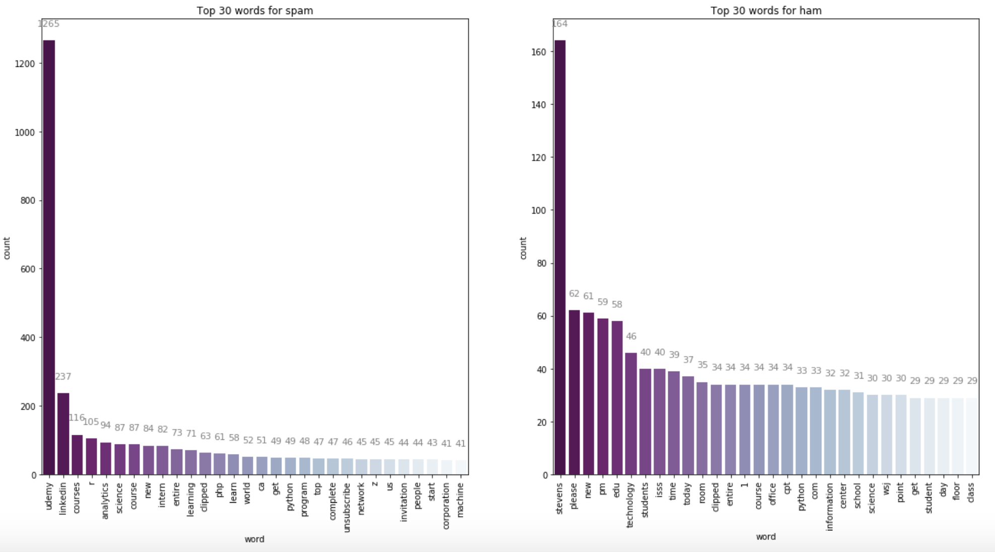
Exploratory Data Analysis
Bar Chart – 2nd
Top 10 words from both labels are different and easy to distinguish

Slide 13
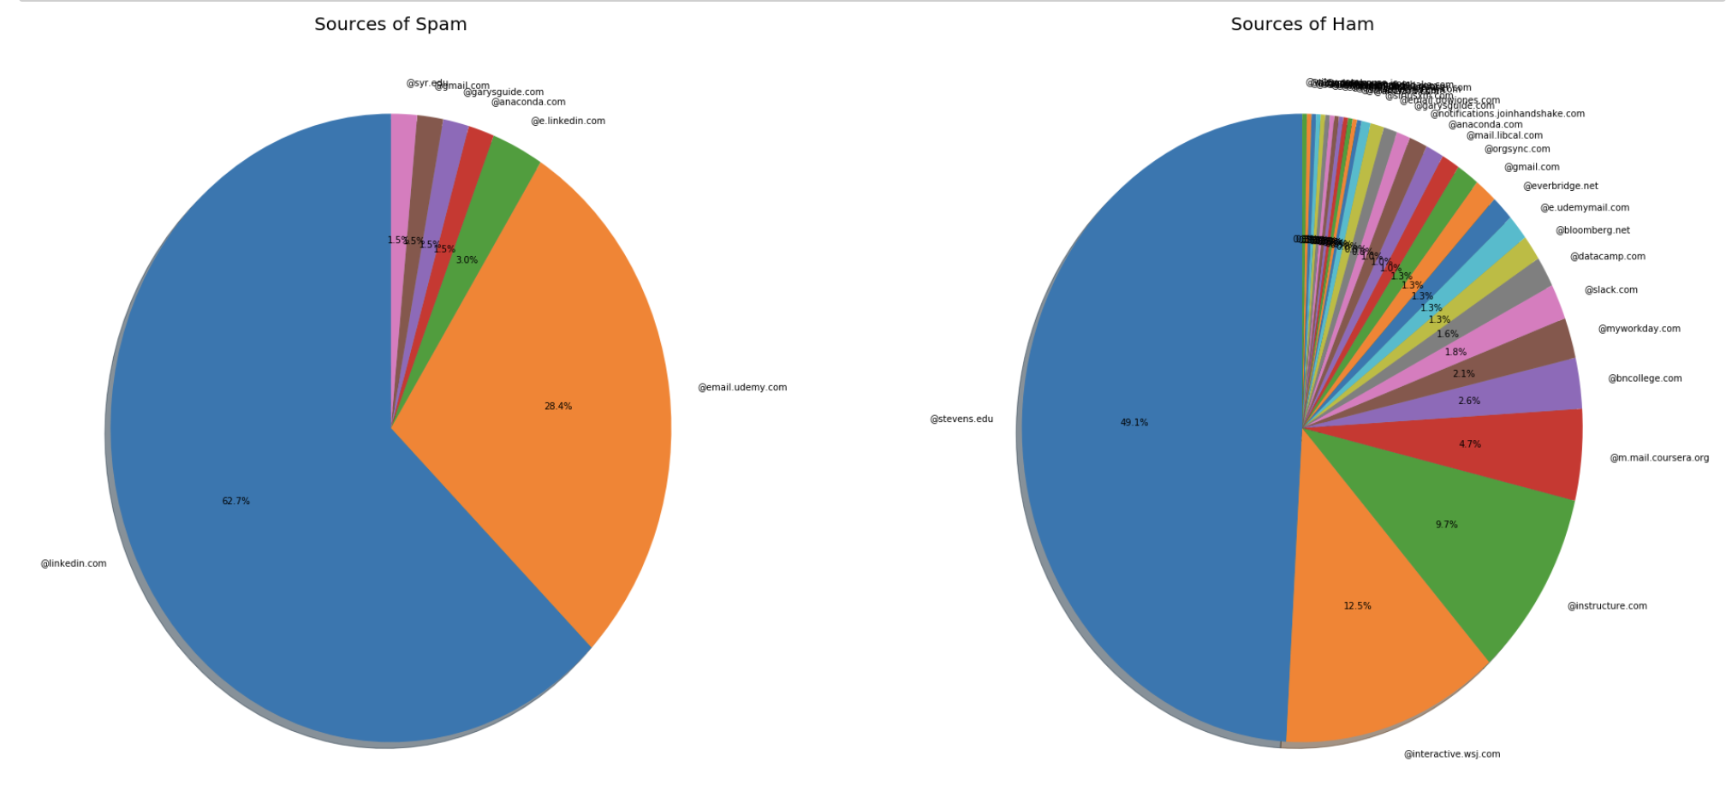
Exploratory Data Analysis
Pie Chart for suffix of email address
Better understand the source of emails from two labels
Perform the EDA part separately
Combine all members’ data and prepare for the modelling

Slide 14
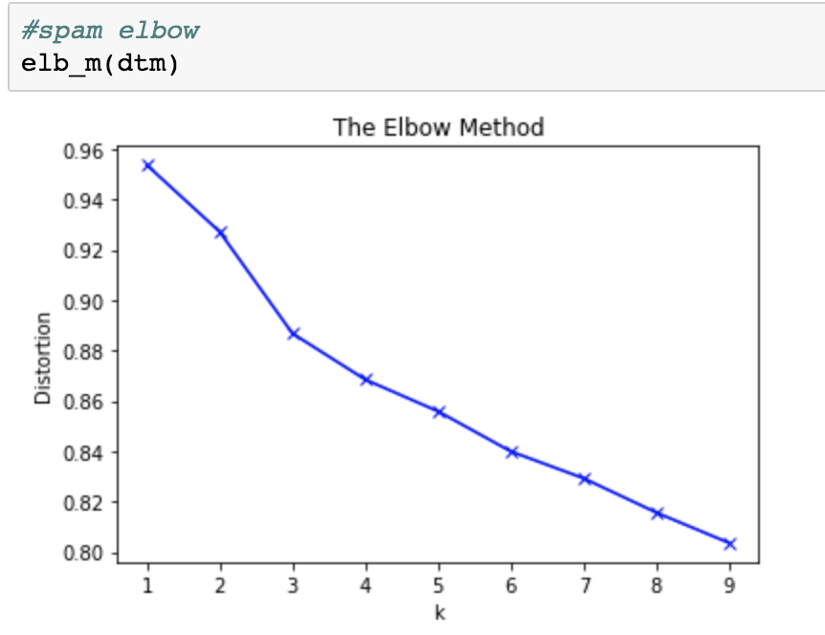
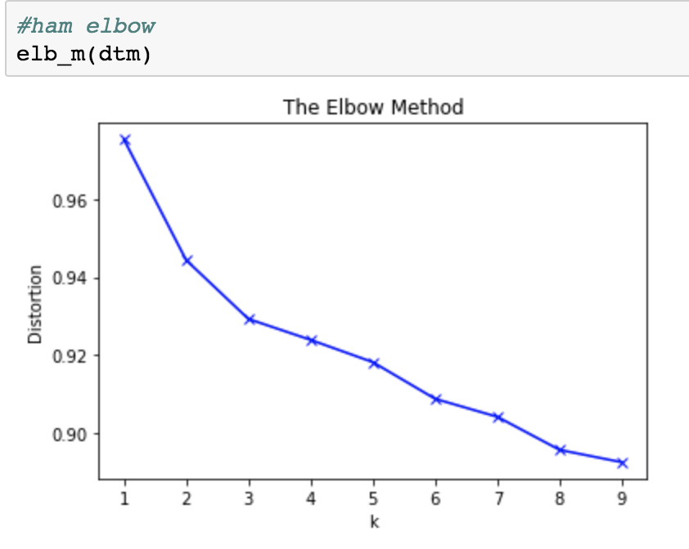
Modelling – Clustering
Find out the relationship between two labels of emails and the email topic
Find out how personal preference related to the email topic
Implement topic modelling to understand the data
Generate a scree plot to determent the number of clusters

Slide 15
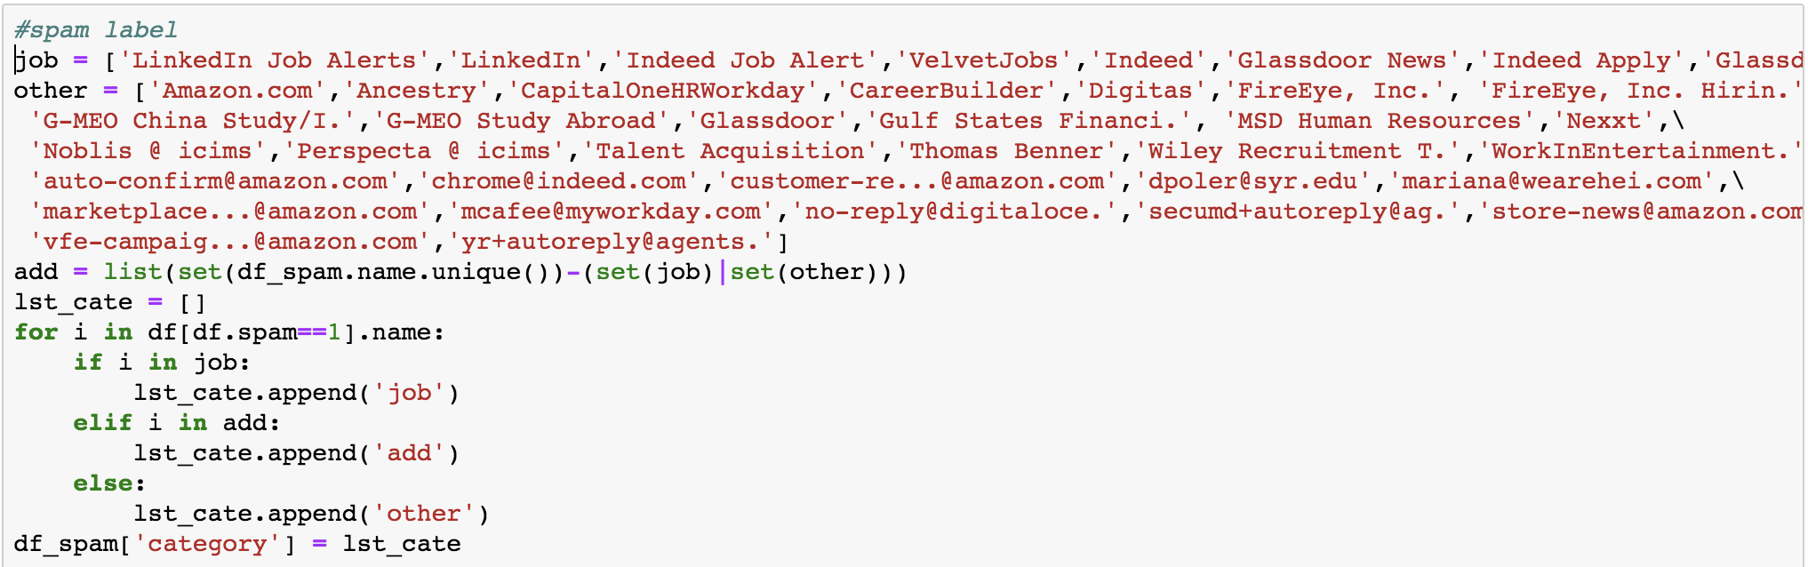
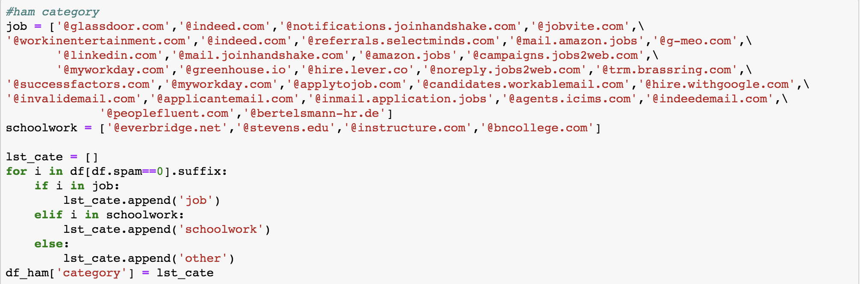
Modelling – Clustering
Manually separate emails into three categories
Add one ‘category’ column
Prepare data for topic modelling

Slide 16
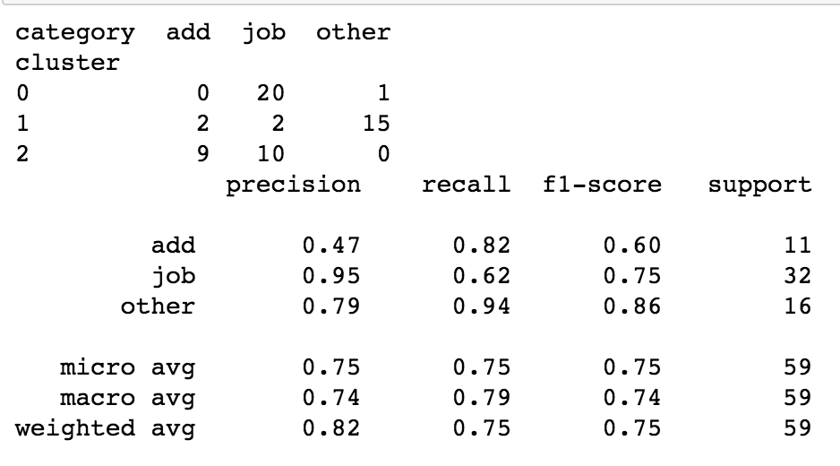
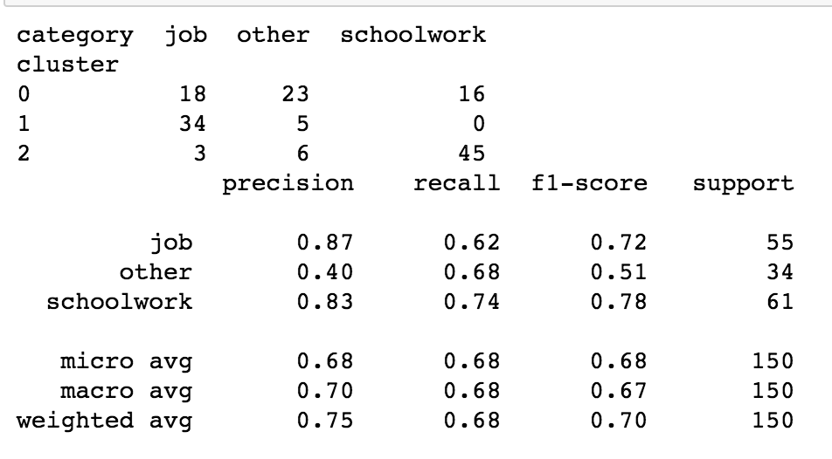
Modelling – Clustering
spam
ham
Clustering performance for spam email is ok
Cluster 2 does has same ration in ‘add’ category email and ‘job’ category email
Clustering performance for ham email is poorer than spam
Cluster 0 can not separate emails clearly into three groups

Slide 17
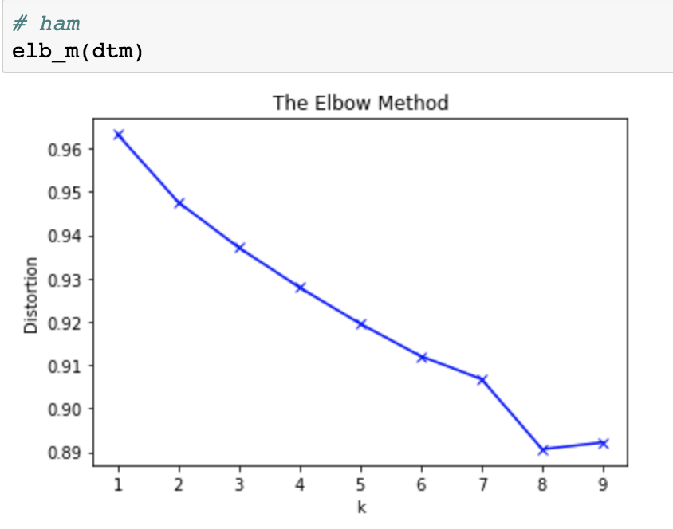
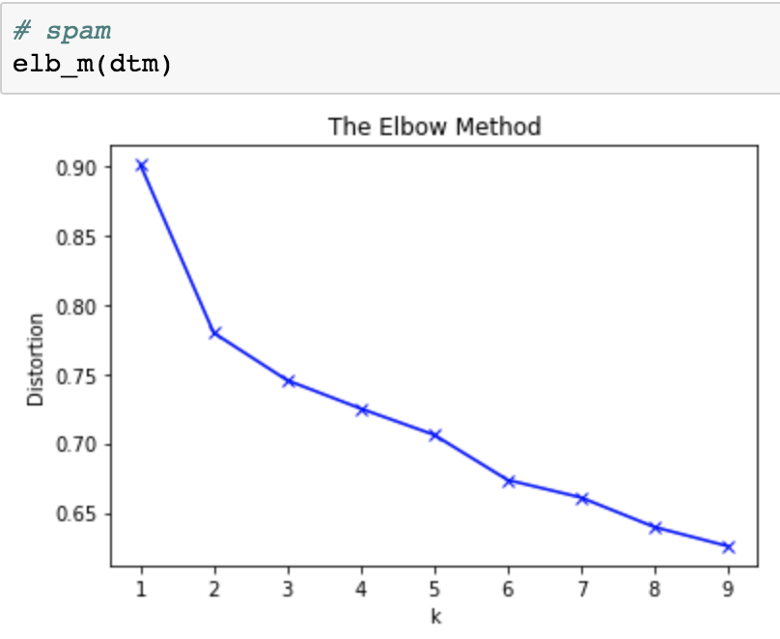
Modelling – Clustering
Take a look at anther team member’s email

Slide 18
Modelling – Clustering
Take a look at anther team member’s email
OOPS!

Slide 19
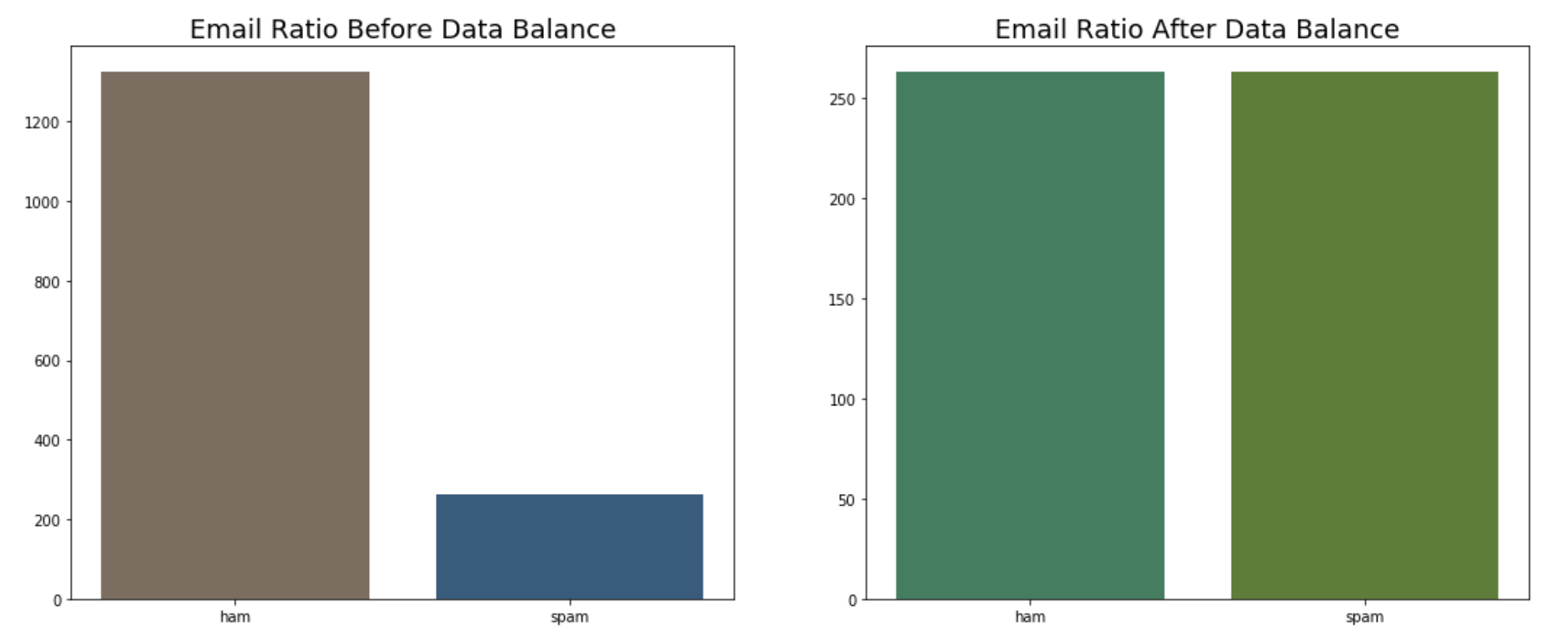
Modelling – Classification
Balance data by setting ration of ham and spam as 1:1
Randomly select the same amount of ham email then append to all spam email

Slide 20
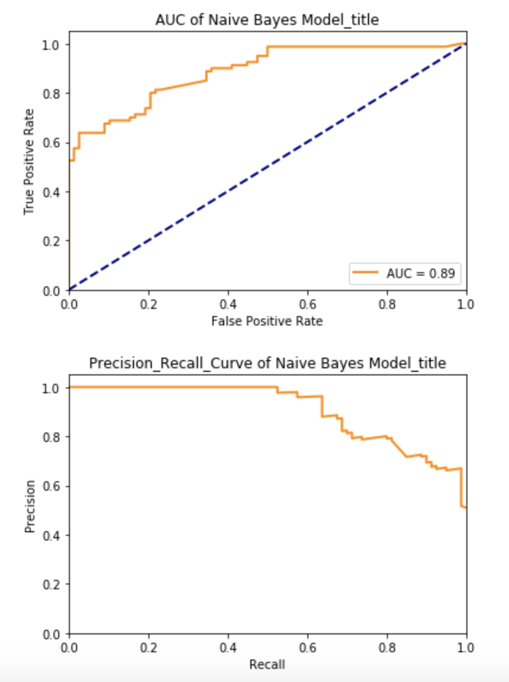
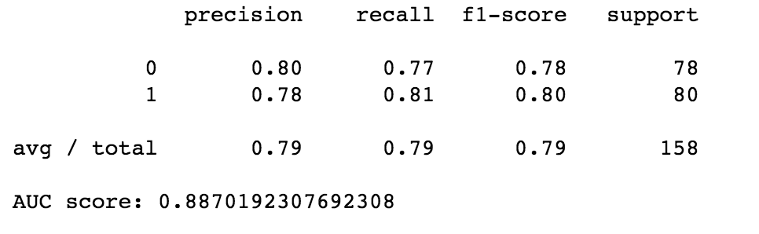
Modelling – Classification
Multinomial Naive Bayes
Use “title” column
Average precision rate: 0.79
AUC score: 0.88

Slide 21
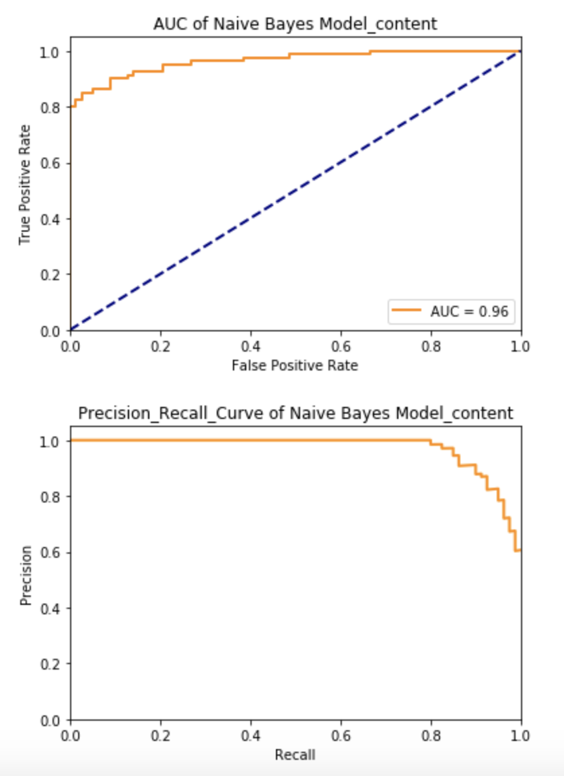
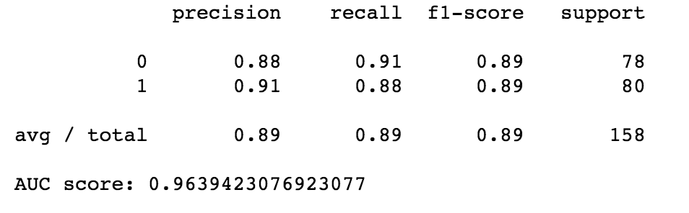
Modelling – Classification
Multinomial Naive Bayes
Use “content” column
Average precision rate: 0.89
AUC score: 0.96

Slide 22
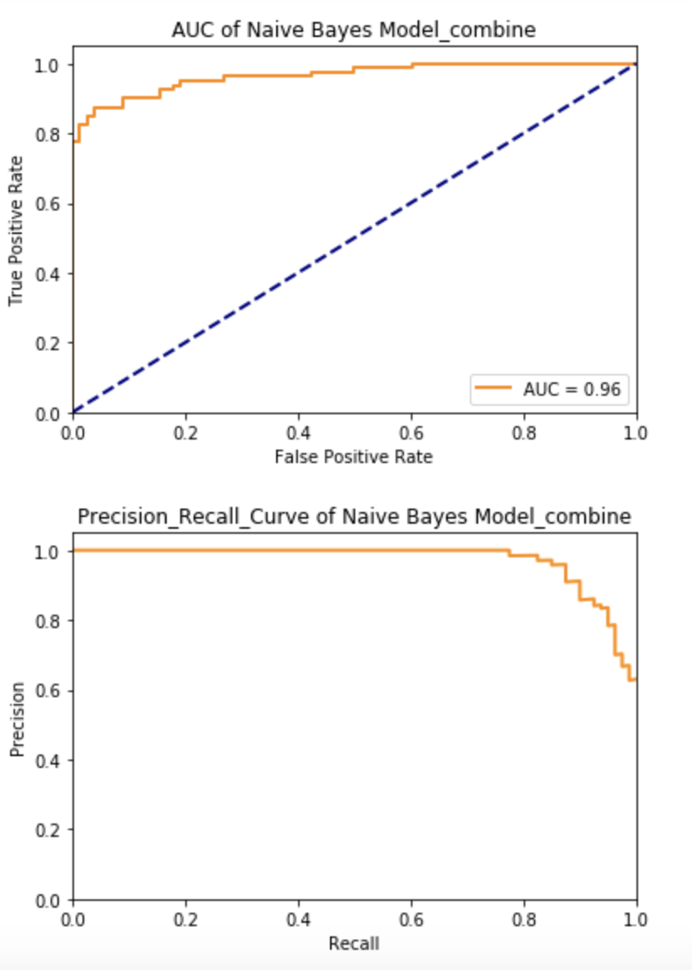
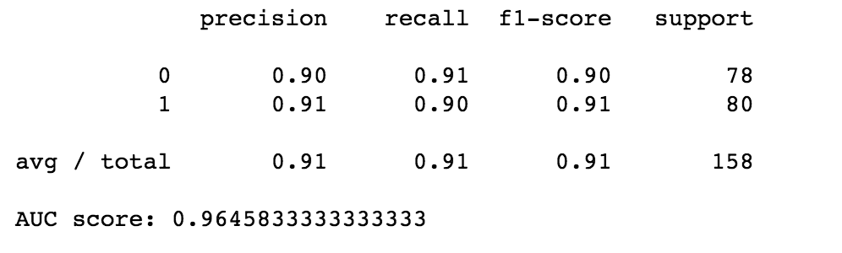
Modelling – Classification
Multinomial Naive Bayes
Use “combine” column
Average precision rate: 0.91
AUC score: 0.96

Slide 23
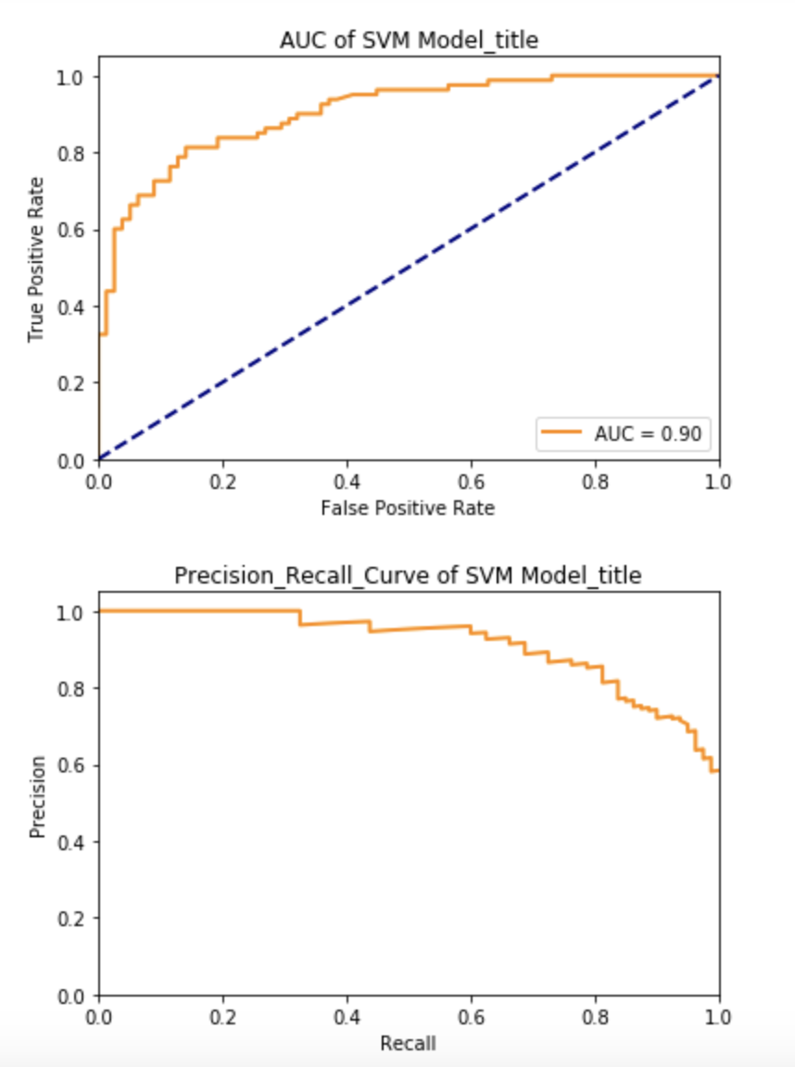
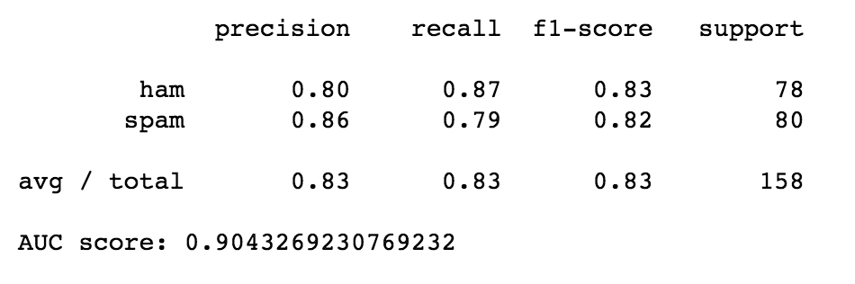
Modelling – Classification
Support Vector Machine
Use “title” column
Average precision rate: 0.83
AUC score: 0.90

Slide 24
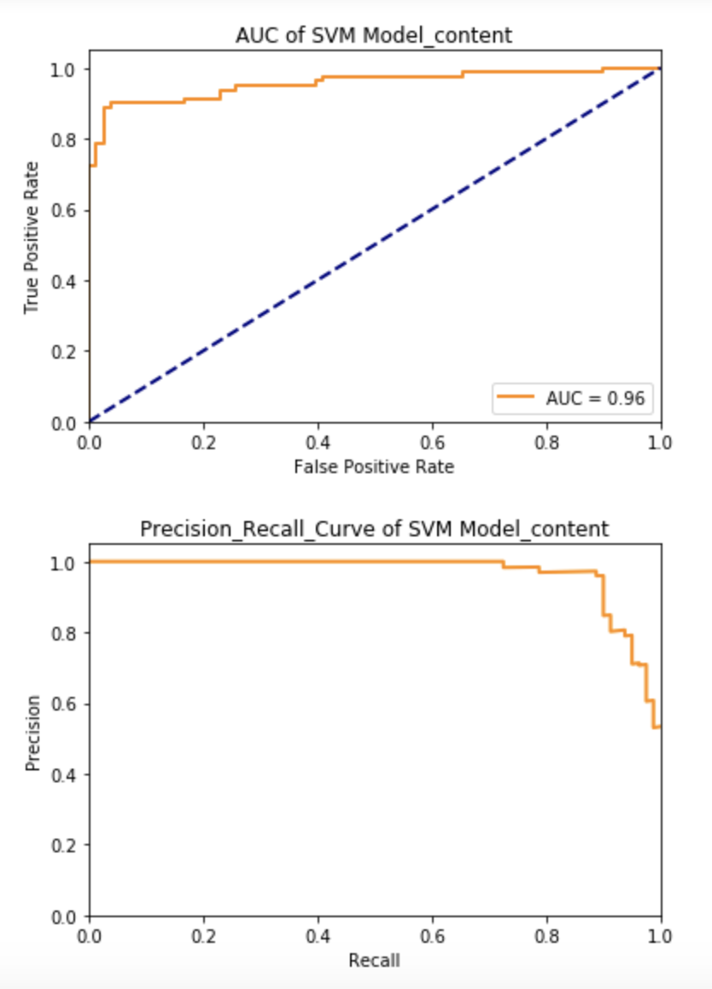
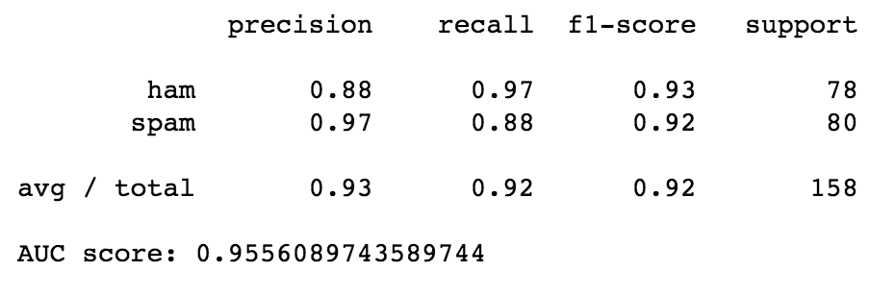
Modelling – Classification
Support Vector Machine
Use “content” column
Average precision rate: 0.93
AUC score: 0.95

Slide 25

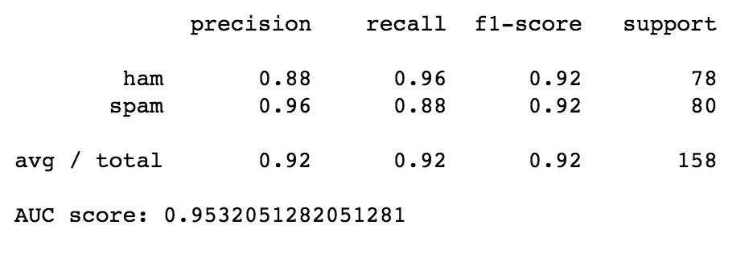
Modelling – Classification
Support Vector Machine
Use “combine” column
Average precision rate: 0.92
AUC score: 0.95

Slide 26
Modelling – Classification
Other Classification Models – “title”

Slide 27
Modelling – Classification
Other Classification Models – “content”

Slide 28
Modelling – Classification
Other Classification Models – “combine”

Slide 29
Results Evaluation
Model types | Advantage | Limitation
Latent Dirichlet Allocation (LDA) | Current model can fit new documents well | Performance in short text will case data sparsity problem
Logistic Regression (LR) | Logistic Regression is the go-to method for binary classification | Widely used in data analysis, not text mining
Support Vector Machine (SVM) | Works well with even unstructured and semi structured data like text, Images | Long training time for large datasets

Slide 30
Results Evaluation
Model types | Advantage | Limitation
Naive Bayes (NB) | Widely used in spam emails classifier: fast, robust and relatively insensitive to missing values and even data imbalance problems | Big dataset is needed
Multinomial Naive Bayes (MNB) | Work well for data which can easily be turned into counts | It will wipe out all information in the other probabilities when they are multiplied

Slide 31
Real World Impact
Provide general knowledge about email's classification
Compare with ”title”, people should pay more attention to the “content” and be careful of using the words frequently appeared in spam emails
Classify new emails into spam or ham relatively accurately
Companies should fragment promotion email further to match user personal preference

Slide 32
Future Work
Take more factors into consideration
Add phrase or n-grams to compare and evaluate the impact
Optimize classification models
Convert pictures into useful information
Consider photos' effect, when processing classification to get more reasonable spam emails prediction

Slide 33
References
https://pythonhosted.org/trustedanalytics/LdaNewPlugin_Summary.html
https://machinelearning-blog.com/2018/04/23/logistic-regression-101/
https://statinfer.com/204-6-8-svm-advantages-disadvantages-applications/
http://www.simafore.com/blog/3-challenges-with-naive-bayes-classifiers-and-how-to-overcome

